Slide 1
Surfing learning analytics on canvas without wiping out
PRESENTATION BY:
Martyn Clark, PhD | Alia Lancaster, PhD

Slide 2
Surfing 101
READING THE WAVES (UNDERSTANDING THE DATA)
RESPECTING THE LOCALS (WORKING WITH CAMPUS GROUPS)
STAY LOW ON THE APPROACH (DON’T PROMISE UNTIL YOU CAN DELIVER)
MASTERING THE LATE DROP (PROTOTYPE BEFORE PRODUCTION)
Image Credits: Shark Surfing by Wolff from the Noun Project, Surfing by Saeful Muslim from the Noun Project, Hang Loose by Trevor Tarczynski from the Noun Project, Surfing by Laymik from the Noun Project, San Diego Ocean Waves by Alfredo @ IconsAlfredo.com from the Noun Project
Notes:
In this presentation, we’ll update you on year two of our Canvas Data journey. We’ll talk about reading the waves (understanding the data), respecting the locals (working with other campus groups), staying low on the approach (don’t promise until you can deliver), and mastering the late drop (prototype before production).

Slide 3
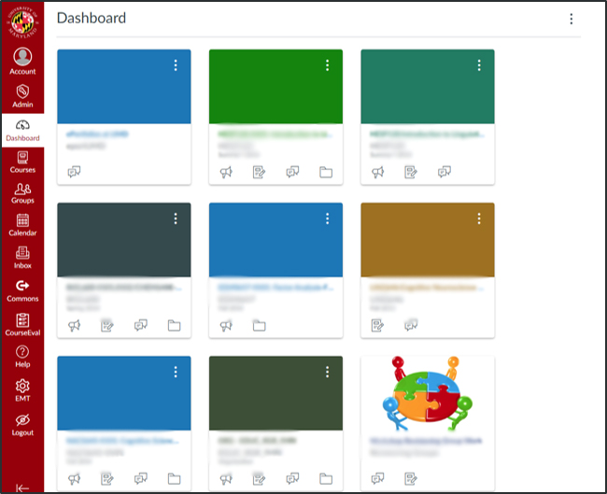
Understanding the data
Notes:
In this presentation, we’ll update you on year two of our Canvas Data journey. We’ll talk about reading the waves (understanding the data), respecting the locals (working with other campus groups), staying low on the approach (don’t promise until you can deliver), and mastering the late drop (prototype before production).

Slide 4
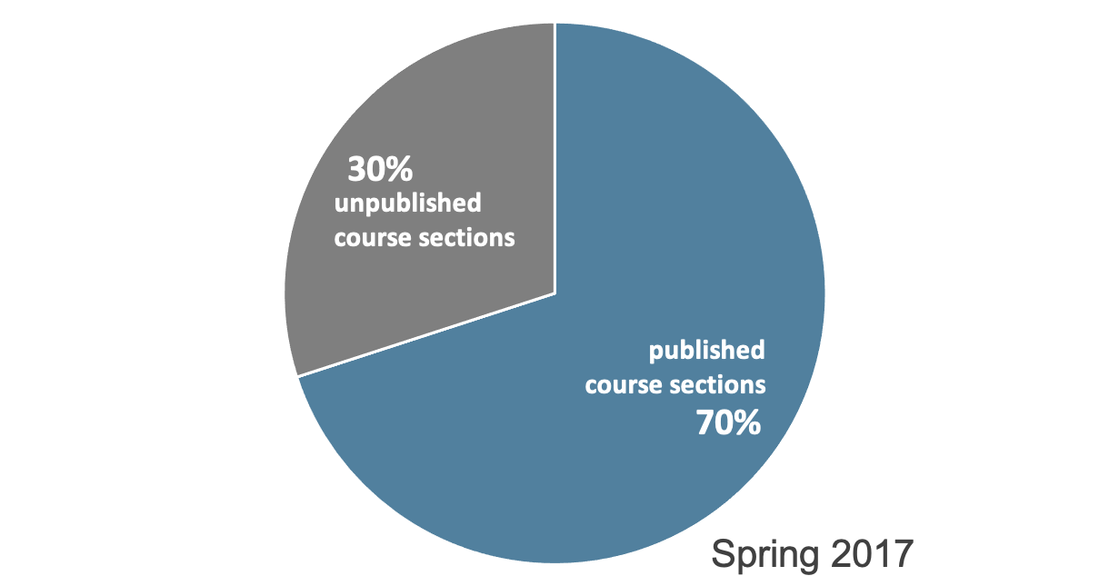
ELMS-Canvas usage
Notes:
In Spring 2017, 70% of course sections published, meaning available to students, on ELMS-Canvas (that’s 6,882 course sections)
Using our no adjectives principle, we know that an average of 70% of a students course sections were published in EC
We don’t know what instructors are doing within those ELMS-Canvas spaces? Are they posting the syllabus, are all assignments submitted online?
Here is where we can pull in another dataset to triangulate information or provide some context

Slide 5
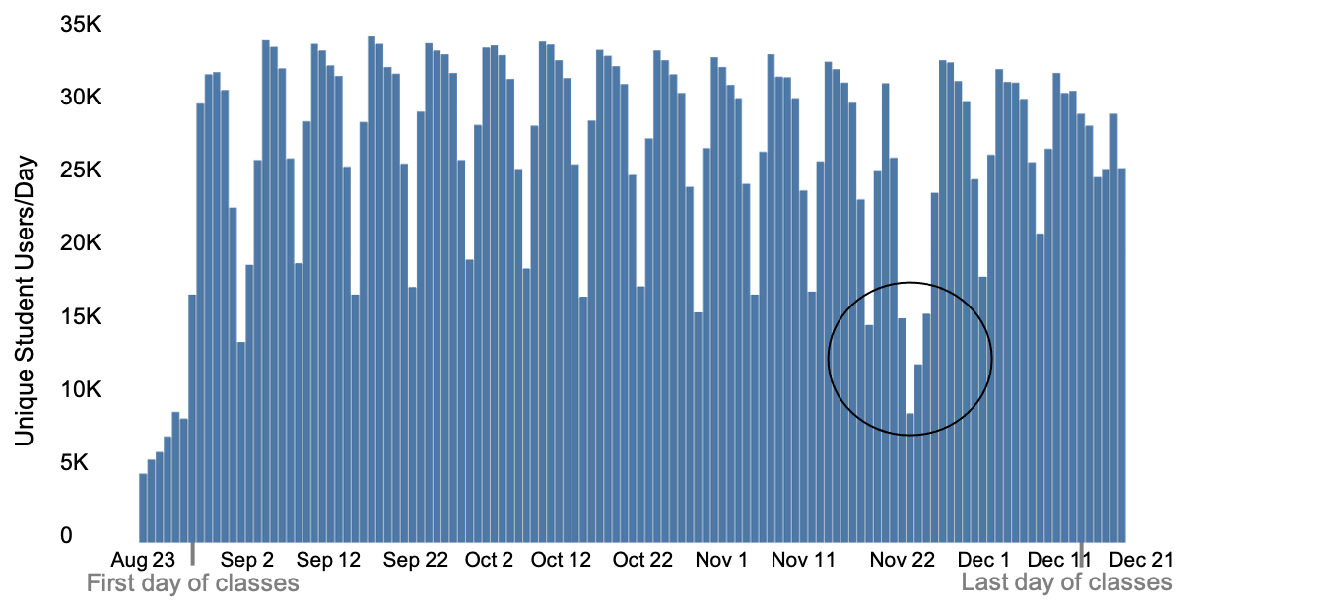
28,129 unique students used ELMS-Canvas on average every day during Fall 2018
Notes:
In this presentation, we’ll update you on year two of our Canvas Data journey. We’ll talk about reading the waves (understanding the data), respecting the locals (working with other campus groups), staying low on the approach (don’t promise until you can deliver), and mastering the late drop (prototype before production).

Slide 6
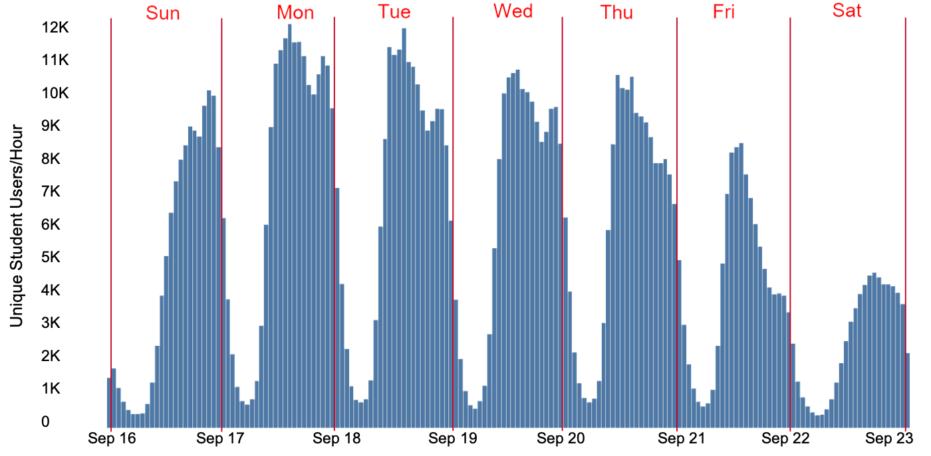

Slide 7
Working with campus groups
Three featured instructor partnerships
Visualize student activity for a large (1000+ students) course
Empirically examine individual differences in cognitive processes, ELMS-Canvas usage, and learning outcomes
Explore how to relate course design and learning outcomes to activity in ELMS-Canvas

Slide 8
Foundations in entrepreneurship
Students explore dynamic company startup topics by working in teams to design a new venture.
Online version has 1500 students
Challenge: How to visualize activity for such a large number of learners?
Notes:
Students explore dynamic company startup topics by working in teams to design a new venture. This multi-disciplinary course helps students to learn the basic business, strategy, and leadership skills needed to launch new ventures. Topics include learning how to assess the feasibility of a startup venture, as well as how to apply best practices for planning, launching, and managing new companies. Students discuss a wide range of issues of importance and concern to entrepreneurs and learn to recognize opportunities, assess the skills and talents of successful entrepreneurs, and learn models that help them navigate uncertainty.

Slide 9
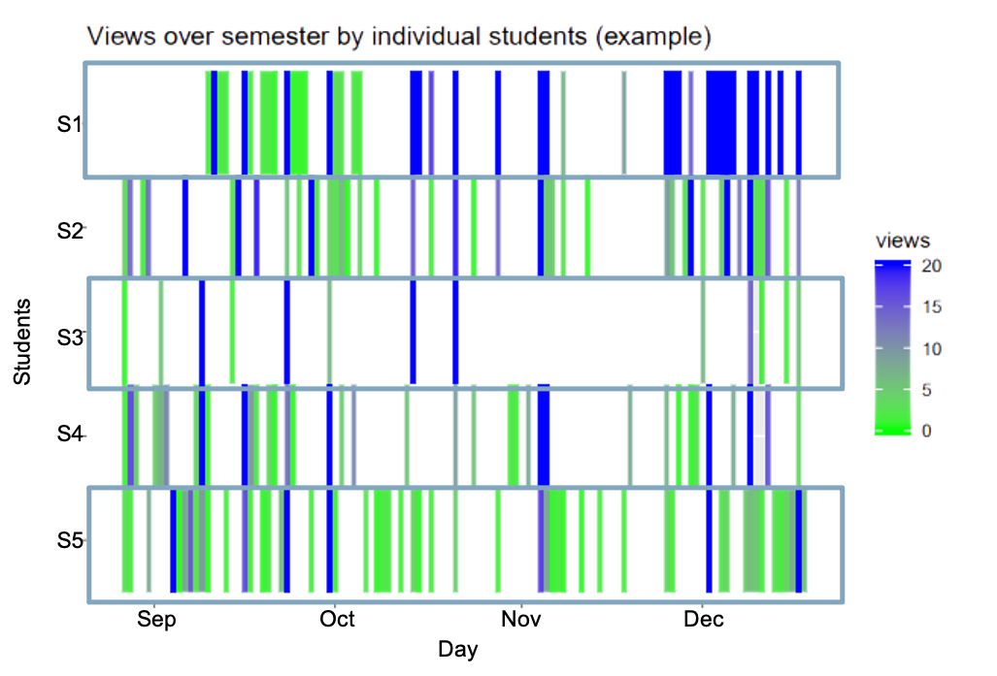

Slide 10
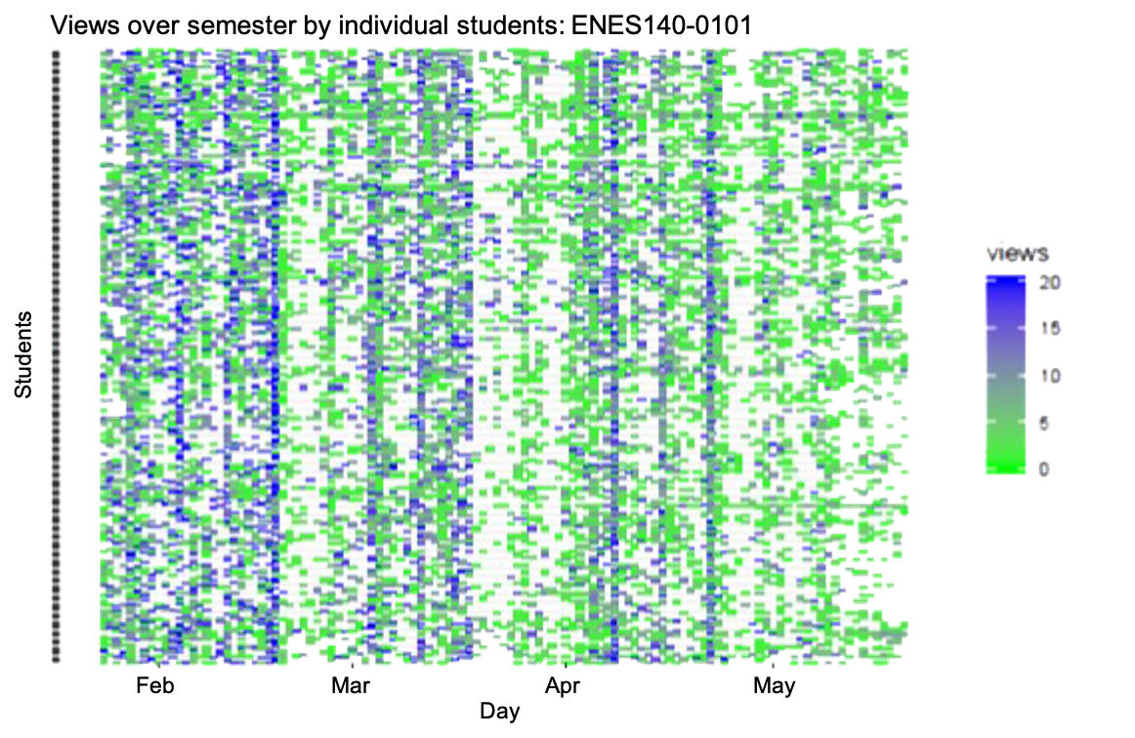

Slide 11
Statistics and research methods
Partnered with instructor and other researchers
Students took cognitive aptitude battery
Challenge: Empirically examine individual differences in cognitive processes, LMS usage, and learning outcomes
Linck, J., Tomlinson, T., Masters, M., Lancaster, A., Clark, M., & Balass, M. (2019). Examining the Relationship Between Executive Control and Student Learning Behaviors. Paper presented at Psychonomics.

Slide 12
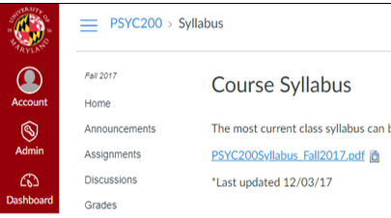
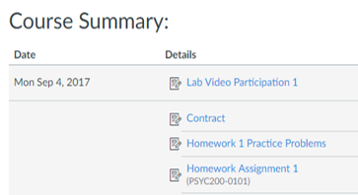
Notes:
Psych 200 and 300: Statistics (Fall) and Research Methods (Spring) progression
First place students usually go: Syllabus. Looking at what is due this week = 1 minute of time in this course space
Click on modules to watch this week’s lab video = a page view on “modules”.
Our 2 LMS variables = total time in course space (minutes) and total page views, both summed over the entire semester

Slide 13
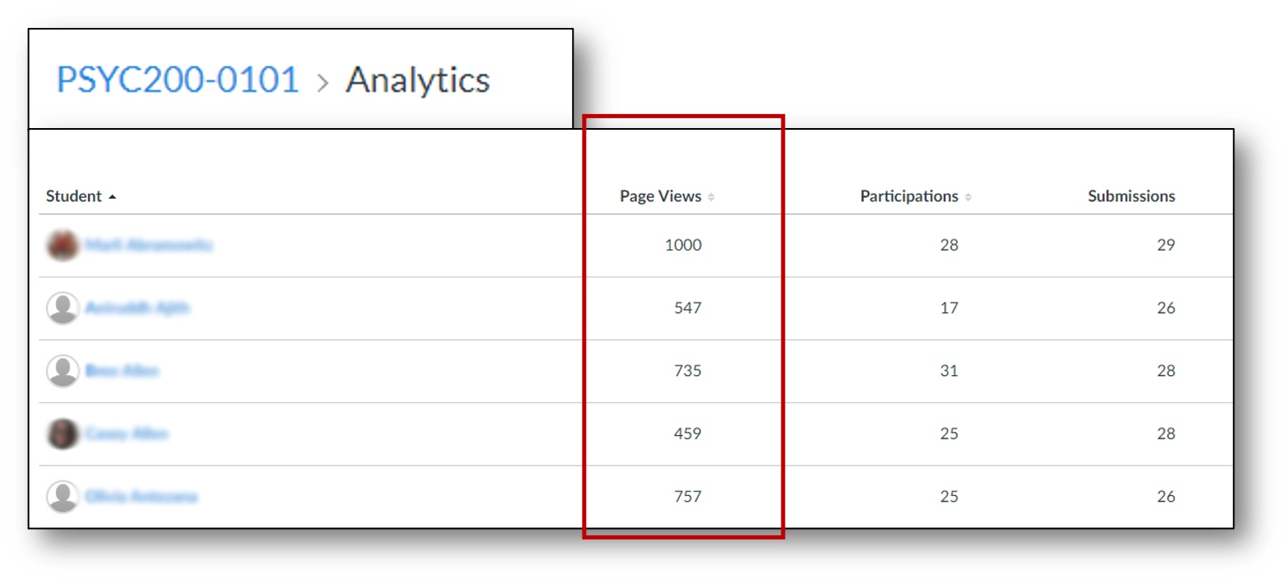
Notes:
We mined the data from the analytics dashboard on Canvas.
Each row represents a student. Of these, focused on page views and total time (not pictured here, in the “people” portion of the course)
There are more sophisticated ways of obtaining the data (e.g., API, we’re building a data warehouse for all UMD’s Canvas Data that we obtain as administrators of the tool). There are also other data points here and that we have access to.
But for now used what is available to instructors and gathering data (i.e., copy and paste to an excel) is manageable for this project to determine feasibility for future analyses.

Slide 14
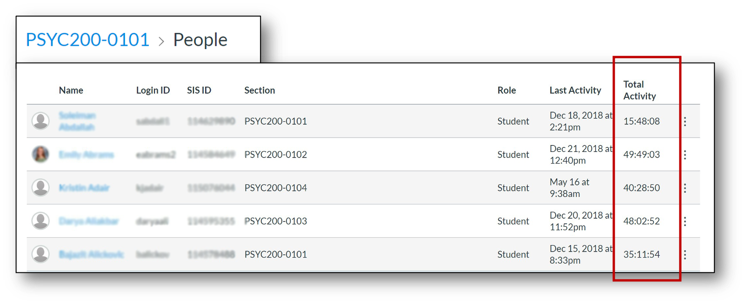

Slide 15
(Dr. Tracy Tomlinson, Psyc 200 & 300, n = 44 & 48)
Simple measures of amount of LMS usage unrelated to Final Course Grades
Cognitive processes unrelated to amount of LMS usage

Slide 16
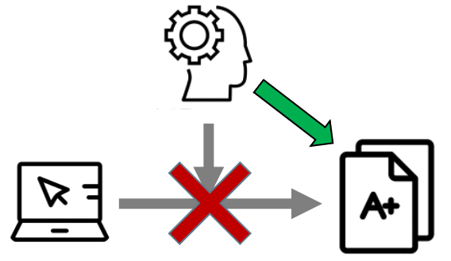
(Dr. Tracy Tomlinson, Psyc 200 & 300, n = 44 & 48)
Final Course Grades
Better Working Memory (updating) and Explicit Rule Induction related to better outcomes
No interactions between LMS usage and cognitive processes

Slide 17
Professional Writing Program
14 courses fulfilling Fundamental Studies GenEd requirements
85 instructors, ~ 7,000 students/year
Largest courses offered in both face-to-face and asynchronous online formats
Challenge: How to relate course design and learning outcomes to activity in ELMS-Canvas
Notes:
PROGRAM review/evaluation
7000/year, about 19/section (50 sections in Spring 2019)
Touches a lot of undergraduates, can characterize their use
Could be replicable in that many universities have these types of programs

Slide 18
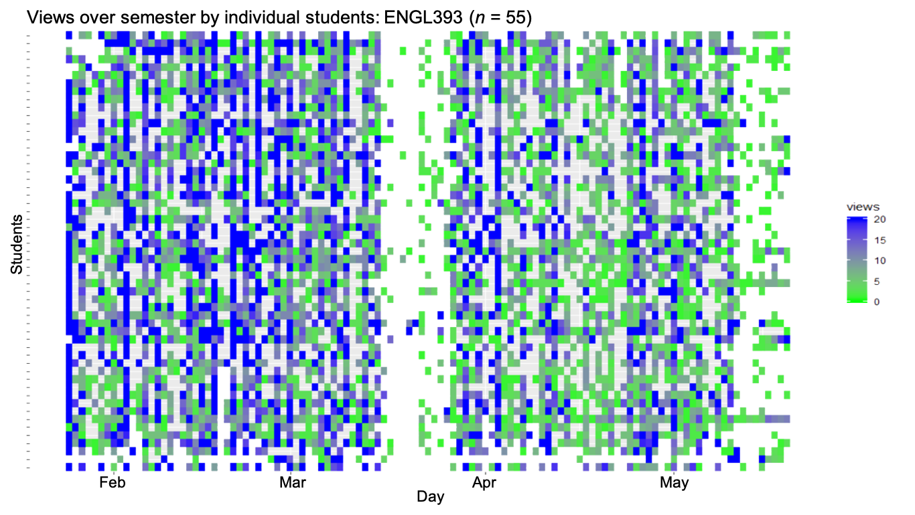

Slide 19
Statistical Analysis (3 sections, n=55)
ELMS-Canvas behaviors
Page views
Discussion entries length (characters)
Learning outcomes
Final grade (%)
Assignment grades (%)
Assignment 1: Extended definition
Assignment 2: Proposal
Assignment 3: Final paper
Notes:
All discussion entries (original posts and replies) – character length more meaningful for this instructor than just whether or not they posted (required assignment)

Slide 20
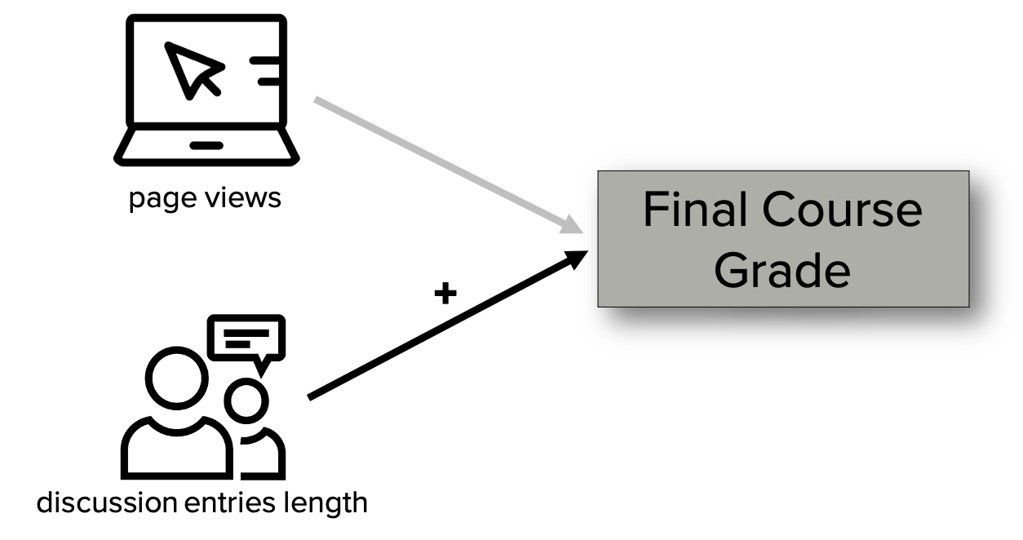
ELMS-Canvas activity during entire semester predicting final grade
Notes:
Regression analysis (can provide details if interested) demonstrated that page views were not related to final course grade
Discussion entry length was positively related. For the average number of page views, every ~8,000 character increase in DEL led to a ~4% increase in final grade). Roughly 1.5 pages single-spaced, 12-pt font
R-squared (adjusted) = 45.26%

Slide 21
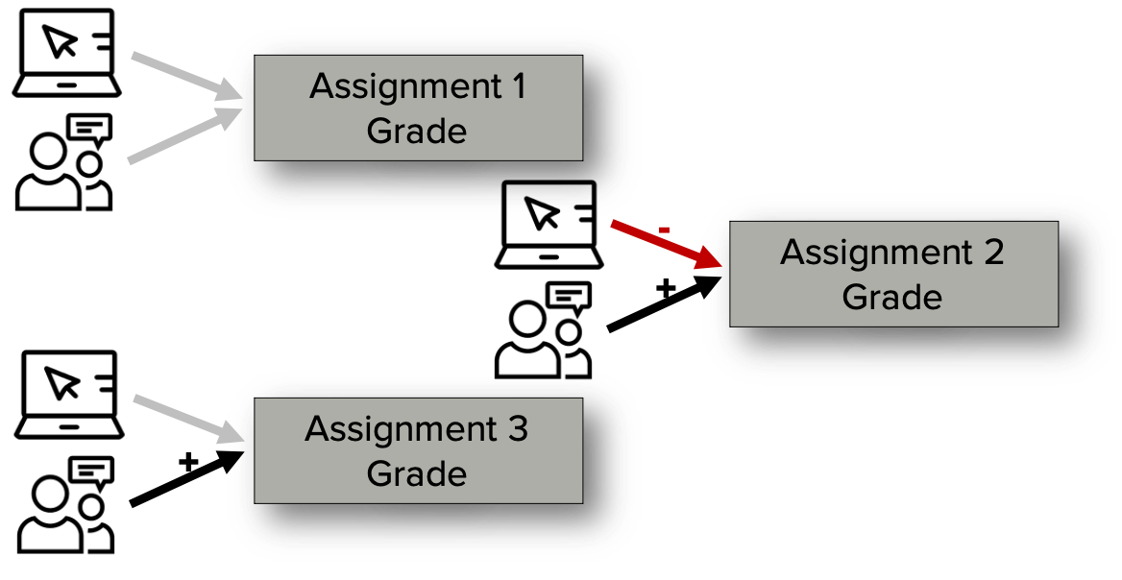
ELMS-Canvas activity during assignment module predicting assignment grade
Notes:
Assignment 1: adjusted r-sq = 2%
Assignment 2: adj r-sq = 11%
For the average discussion entries length, every one standard deviation increase in page views (45) led to a 2.02% decrease in proposal grade.
For the average page views, every one standard deviation increase in discussion entries length (2,615) led to a 2.18% increase in proposal grade
Assignment 3: (includes proposal as covariate) adj r-sq = 50%
For the average proposal grade and page views, every one standard deviation increase in discussion entries length (4,264) led to a final project grade increase of 1.39%
Some interesting patterns here. Don’t want to over-interpret, however. Next step is to apply the same analyses to courses that use the same course shell

Slide 22
Summary
ELMS-Canvas activity generally follows course design
Page views over entire course not related to final grade (in these courses)
Page views and discussion entries length may be related to learning outcomes during modules
Notes:
Affordances of the course space online impact the behavior we see in the system
Activity = page views
Cognitive abilities = WM and explicit rule induction
Module learning assignments: don’t want to overstate what we’ve seen in only 3 sections of 1 course, but there might be something “moving in the bushes” in terms of intentionally designing a course and learning outcomes when we look at this smaller time window

Slide 23
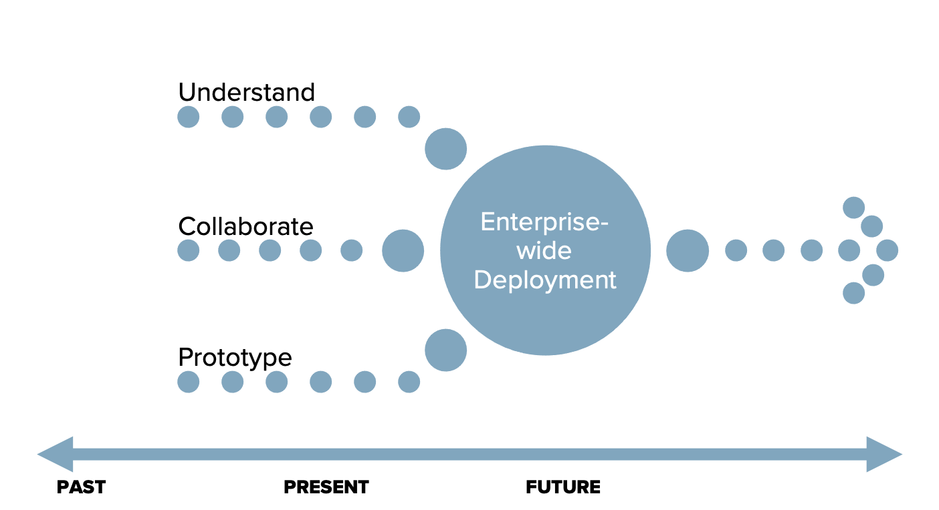
Prototype before production
Notes:
Staying low on the approach. Although we haven’t had a master plan per se, we have tried to be intentional in moving forward with our Canvas data project. There is a multi-year data modernization project underway on campus (some of our core student systems have been around for decades), so we wanted to do our due diligence with Canvas data so that we will be ready when our time comes.

Slide 24
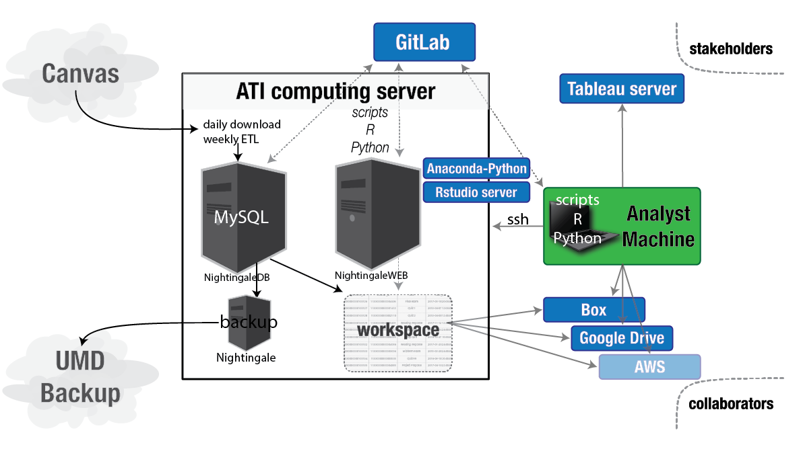
Notes:
Mastering the late drop

Slide 25
Academic Technology Experience Team
Alia Lancaster abiller@umd.edu
Megan Masters, Director mkrol@umd.edu
Martyn Clark mclark19@umd.edu

