Slide 1
Leveraging LMS Data to Understand Student Engagement
Megan Masters, PhD, Alia Lancaster, PhD, Martyn Clark, PhD

Slide 2
Three Main Take-Aways
ELMS-Canvas:
A critical component of the teaching and learning experience
Patterns in usage provide insights into the overall student learning experience
Data housed within ELMS-Canvas serves robust resource for learning analytic research that can inform instructional design practices
ELMS = Enterprise Learning Management System

Slide 3
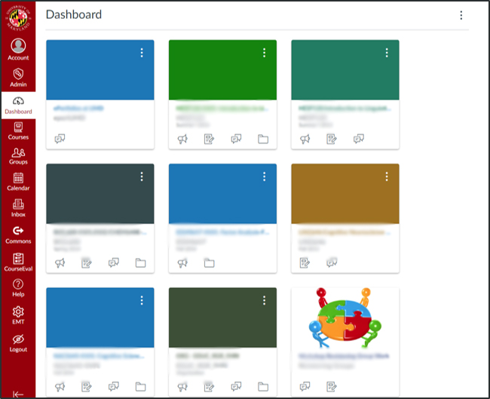
ELMS-Canvas usage
Notes:
Who uses Canvas as their Enterprise Learning Management system (ELMS)?
Can be a common course space online for instructors and students
Each semester a space automatically generated within our ELMS-Canvas instance (with exception of some types of sections, like independent study)
Instructor can publish a space = ACCESS available to students
Available since Fall 2012. Many teams within DIT piloted, implemented, and maintain

Slide 4
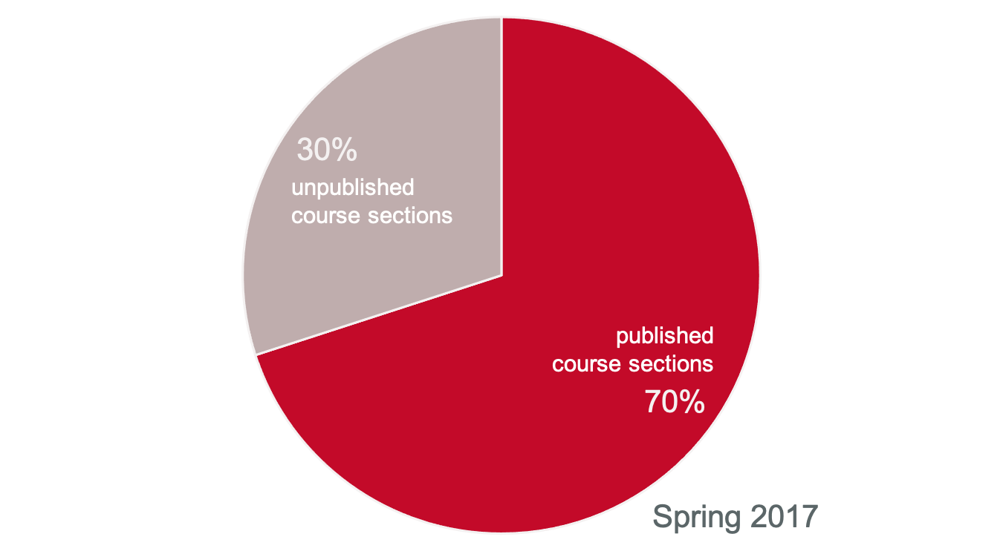
ELMS-Canvas usage
Notes:
In Spring 2017, 70% of course sections published, meaning available to students, on ELMS-Canvas (that’s 6,882 course sections)
Using our no adjectives principle, we know that an average of 70% of a students course sections were published in EC
We don’t know what instructors are doing within those ELMS-Canvas spaces? Are they posting the syllabus, are all assignments submitted online?
Here is where we can pull in another dataset to triangulate information or provide some context

Slide 5
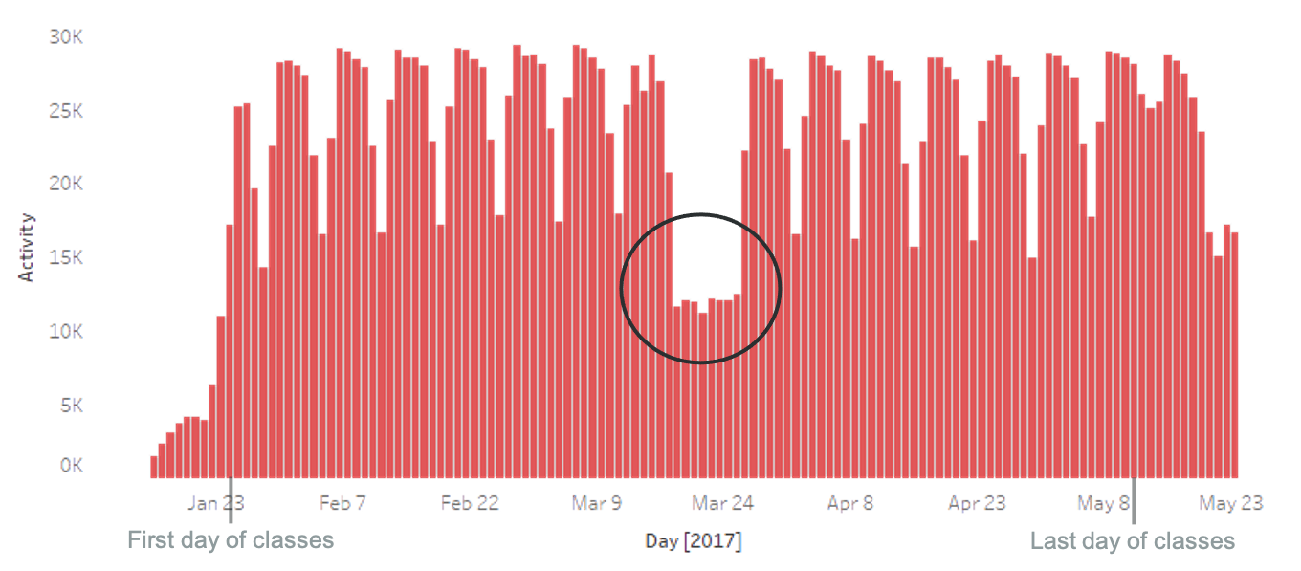
ELMS-Canvas usage
25,185 unique students used ELMS-Canvas on average every day during Spring 2017
Notes:
Spring break is a good check – we would expect there to be fewer users
25185/39,000 = 65%
Pervasive learning technology that DIT supports that touches 65% of on a daily basis. And that’s just 1 tool that DIT provides, not to mention the other services.
Spring break = gut check. Out expectations about the patterns were met. Situation with the opposite.
First day of classes: Jan 25, last day: May 11

Slide 6
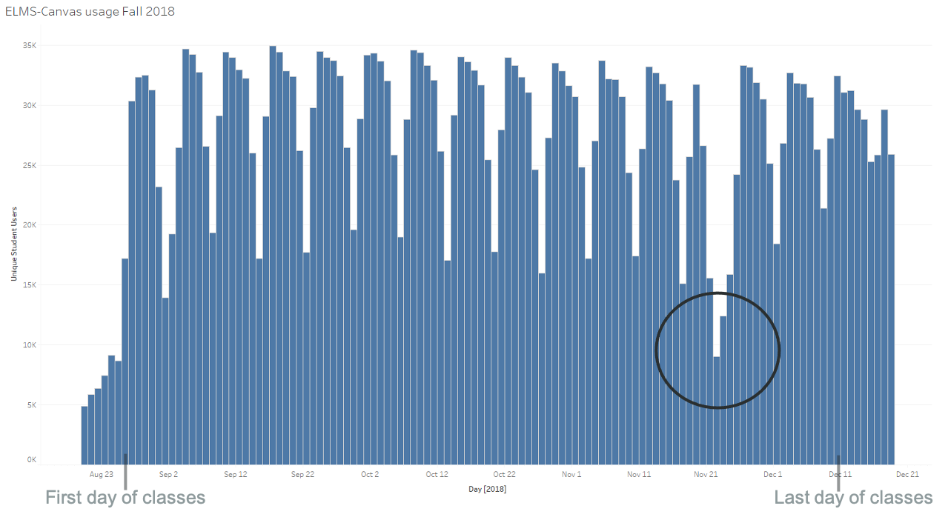
ELMS-Canvas usage
28,129 unique students used ELMS-Canvas on average every day during Fall 2018
Notes:
Average is for period Aug 27 – December 10
This number is JUST students and JUST activity related to a Fall 2018 course
28,129 / 41,200 = 68% of all students
Peak use was 34,924 on September 17, 2018. (85% of all students)
Thanksgiving is a good check – we would expect there to be fewer users
Averages per day
Sunday 26,444
Monday 31,245
Tuesday 30,942
Wednesday 30,036
Thursday 28,640
Friday 23,834
Saturday 17,474
Pervasive learning technology that DIT supports that touches 65% of on a daily basis. And that’s just 1 tool that DIT provides, not to mention the other services.
First day of classes: Jan 25, last day: May 11

Slide 7
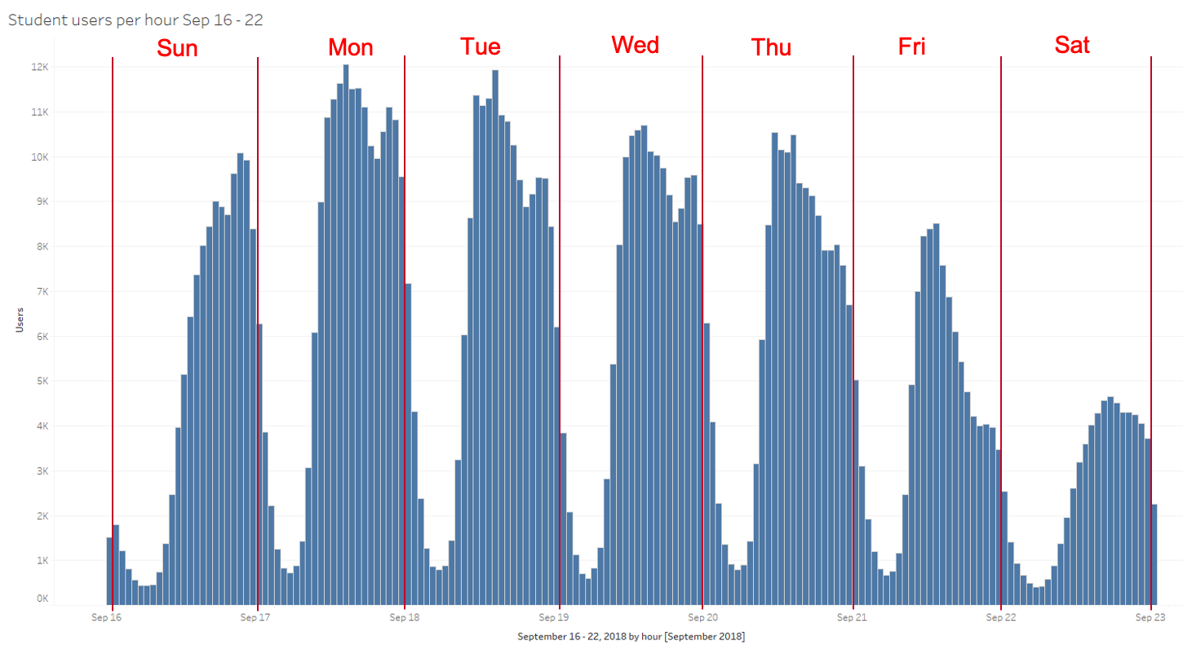
ELMS-Canvas usage
Notes:
This chart is the number of unique student users per hour for a week in Fall 2018
September 16 (Sunday) midnight – 1:00 AM through September 22 (Saturday) 11:00 PM – midnight
Most days, usage tends to peak at 2:00 PM, with a secondary uptick around 9:00 PM
Lowest usage is around 5:00 AM in the morning
The largest number of hourly users here was around 2:00 PM on Monday, September 17 (12,050 users)
Because of the difficulty in unambiguously disambiguating human activity from system activity in the log table, this chart is best for understanding general trends rather than obsessing on exact numbers

Slide 8
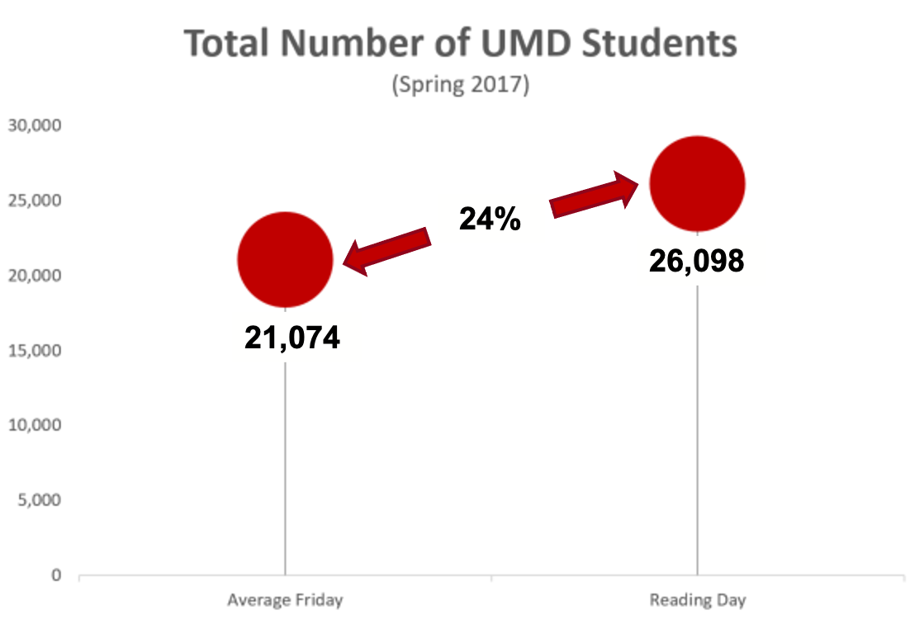
ELMS-Canvas usage on reading day

Slide 9
Individual course analytics
Understanding learning patterns within ELMS-Canvas
Learning analytics
Data mining, machine learning, natural language processing, visualization, human computer interaction, linguistics, education
How do we move from “clicks” to “constructs”?
How might insights inform teaching and learning practices?
Notes:
Simultaneously exploring university usage patterns and individual course analytics, which compliment one another in terms of helping us understand the dataset but also what insights are useful for different audiences (e.g., working groups, instructors, learning)
LA = young, interdisciplinary, emerging field, becoming familiar with literature
Incorporating it with our own dataset
2 caveats: imperfect measures (many steps from clicks to learning) and only 1 part of the student experience
Often situated under the umbrella terms of “data science”, “educational data mining”, “big data”, and “big science”
How do we employ data mining, machine learning, natural language processing, visualization, and human-computer interaction to provide educators and learners with insights that might improve learning processes and teaching practices?
Enables both instructors and learners to visually inspect their own process and progress
Potential intersection between learning analytics integration and use
Makes previously invisible processes and progress visible
The following slides display some of the insights that we've learned in patterns of course-specific student activity.
Makes previously invisible processes and progress visible

Slide 10
Individual course analytics
Three featured instructor partnerships
Visualize student activity for a large (1000+ students) course
Empirically examine individual differences in cognitive processes, ELMS-Canvas usage, and learning outcomes
Explore how to relate course design and learning outcomes to activity in ELMS-Canvas
Notes:
Each course and instructor was different, and so were interested in different elements of the ELMS-Canvas data.
Co-developed metrics that were meaningful to the instructors, which also addressed new challenges for us in processing and visualizing the data

Slide 11
Foundations in Entrepreneurship
Discovering New Ventures: Foundations in Entrepreneurship (ENES140)
Students explore dynamic company startup topics by working in teams to design a new venture.
Online version has 1500 students
Challenge: How to visualize activity for such a large number of learners?
Notes:
Students explore dynamic company startup topics by working in teams to design a new venture. This multi-disciplinary course helps students to learn the basic business, strategy, and leadership skills needed to launch new ventures. Topics include learning how to assess the feasibility of a startup venture, as well as how to apply best practices for planning, launching, and managing new companies. Students discuss a wide range of issues of importance and concern to entrepreneurs and learn to recognize opportunities, assess the skills and talents of successful entrepreneurs, and learn models that help them navigate uncertainty.

Slide 12
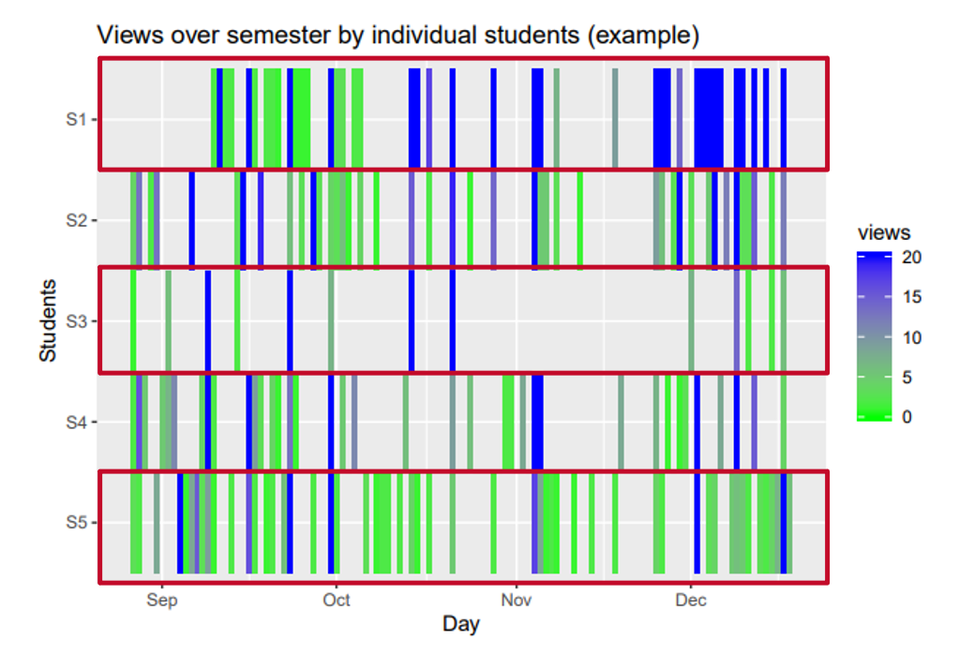
Exploring patterns in student activity within the ELMS-Canvas platform
Notes:
Explanation

Slide 13
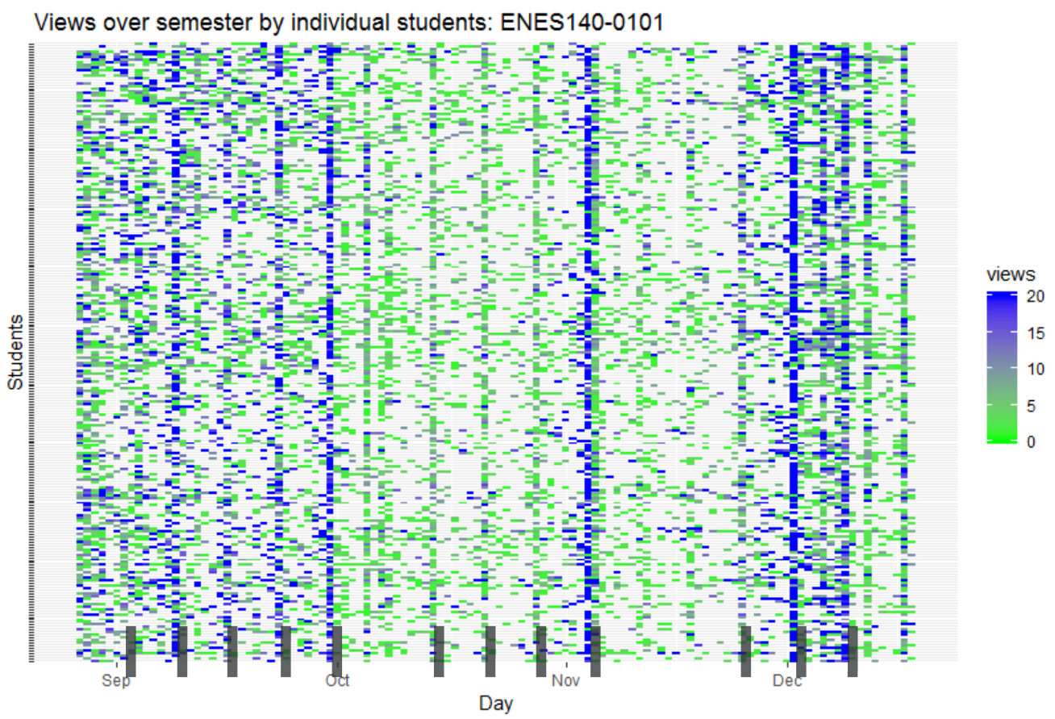
Exploring patterns in student activity within ELMS-Canvas
Discovering New Ventures
(Dr. James Vaughn-Green, ENES 140, n = 239)
Notes:
What are blue lines?
Despite pretty consistent assignments (plus weekly modules which are released only 2 weeks in advance), more views in beginning and end of the semester.
Not necessarily good or bad (it’s a long way from ELMS-Canvas page views to learning). Could be less engagement during the middle of the term or could getting acclimated to the course space in the first month, familiarity in the middle, and final project views at the end.

Slide 14
Statistics and Research Methods Courses
Statistics and Research Methods Courses
Partnered with instructor and other researchers
Students took cognitive aptitude battery
Challenge: Empirically examine individual differences in cognitive processes, LMS usage, and learning outcomes
Linck, J., Tomlinson, T., Masters, M., Lancaster, A., Clark, M., & Balass, M. (2019). Examining the Relationship Between Executive Control and Student Learning Behaviors. Paper presented at Psychonomics.
Notes:
Need to add citation

Slide 15
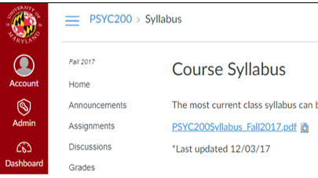
Statistics and Research Methods Courses
Notes:
Psych 200 and 300: Statistics (Fall) and Research Methods (Spring) progression
First place students usually go: Syllabus. Looking at what is due this week = 1 minute of time in this course space
Click on modules to watch this week’s lab video = a page view on “modules”.
Our 2 LMS variables = total time in course space (minutes) and total page views, both summed over the entire semester

Slide 16
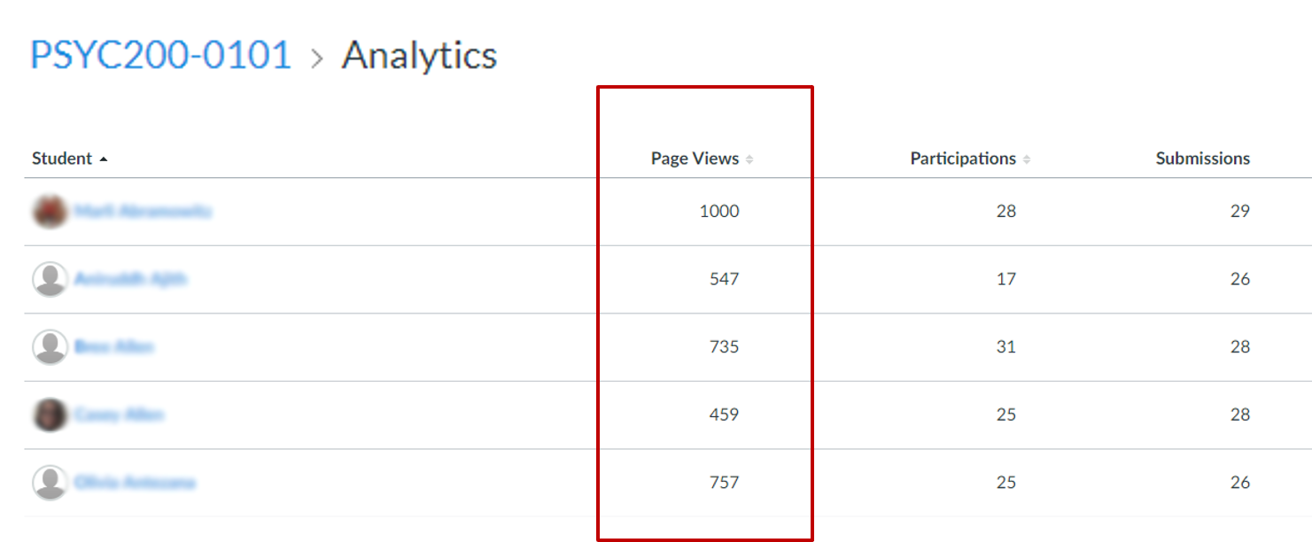
Statistics and Research Methods Courses
Notes:
We mined the data from the analytics dashboard on Canvas.
Each row represents a student. Of these, focused on page views and total time (not pictured here, in the “people” portion of the course)
There are more sophisticated ways of obtaining the data (e.g., API, we’re building a data warehouse for all UMD’s Canvas Data that we obtain as administrators of the tool). There are also other data points here and that we have access to.
But for now used what is available to instructors and gathering data (i.e., copy and paste to an excel) is manageable for this project to determine feasibility for future analyses.

Slide 17
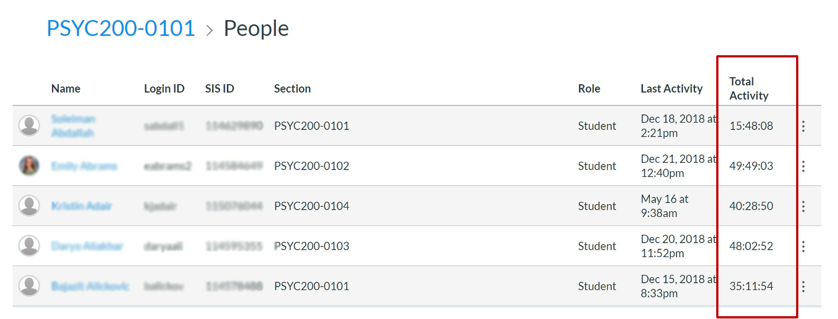
Statistics and Research Methods Courses

Slide 18
Statistics and Research Methods Courses
(Dr. Tracy Tomlinson, Psyc 200 & 300, n = 44 & 48)
Simple measures of amount of LMS usage unrelated to Final Course Grades
Cognitive processes unrelated to amount of LMS usage

Slide 19
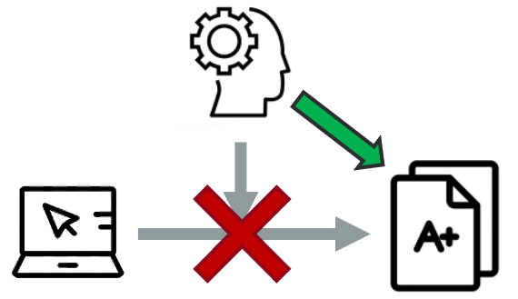
Statistics and Research Methods Courses
(Dr. Tracy Tomlinson, Psyc 200 & 300, n = 44 & 48)
Final Course Grades
Better Working Memory (updating) and Explicit Rule Induction related to better outcomes
No interactions between LMS usage and cognitive processes
Notes:
Transition: explore relationship in another modality
Clicks does not equal behavior. Null results are fine

Slide 20
Professional Writing Program Course
Professional Writing Program (PWP)
14 courses fulfilling Fundamental Studies GenEd requirements
85 instructors, ~ 7,000 students/year
Largest courses offered in both face-to-face and asynchronous online formats
20+ online instructors
Challenge: How to relate course design and learning outcomes to activity in ELMS-Canvas
Notes:
PROGRAM review/evaluation
7000/year, about 19/section (50 sections in Spring 2019)
Touches a lot of undergradutes, can characteriaze their use
Could be replicable in that many universities have these types of programs

Slide 21
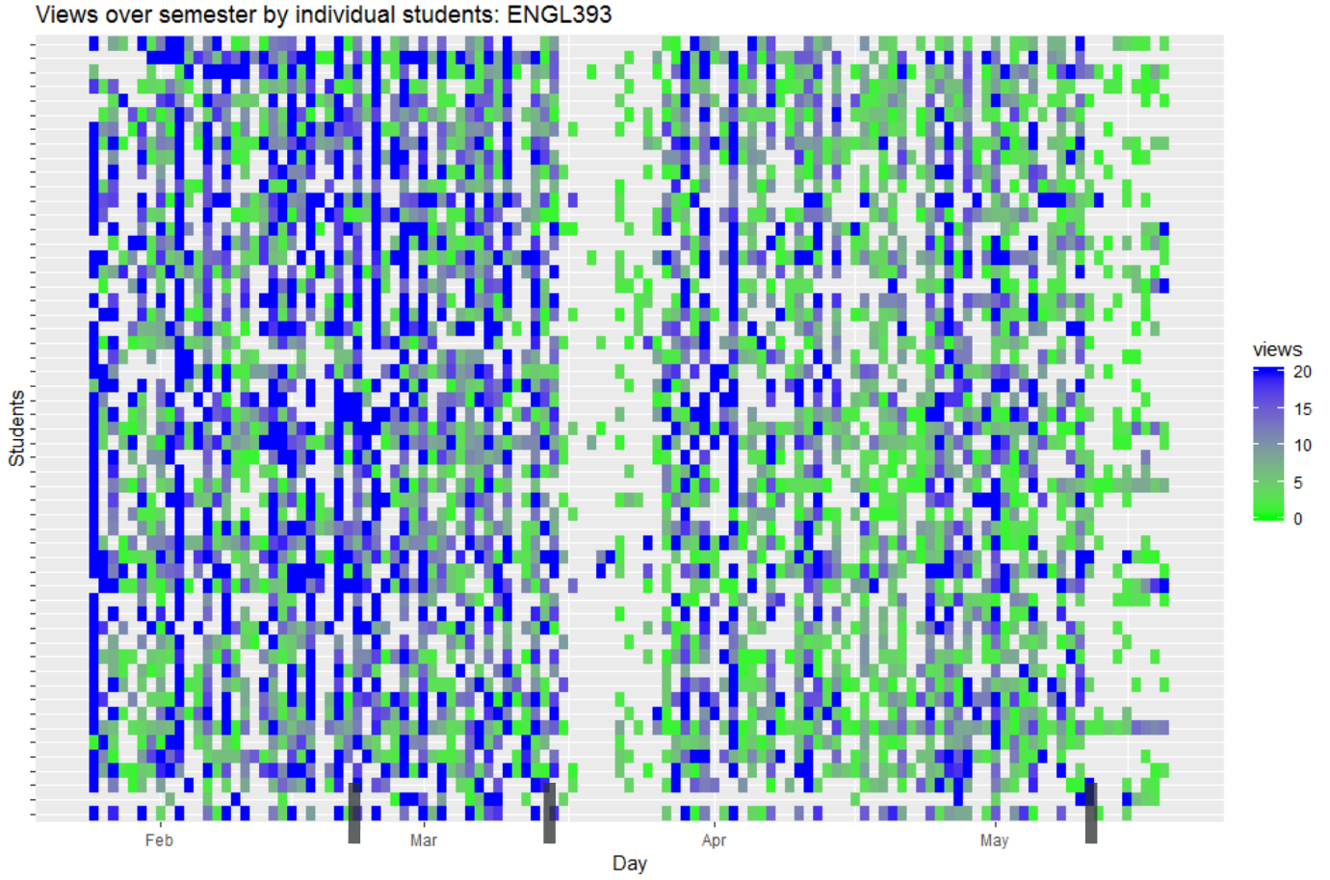
Exploring patterns in student activity within ELMS-Canvas
ENGL393 (n = 55)
(Scott Moses)
Notes:
Similar pattern of activity. Red lines indicate major assignments. As this is a writing class, a lot of the “work” happens offline, by design.
Course was designed be front-heavy, with a final paper as the final project (other assignments were extended definition and proposal)

Slide 22
Professional Writing Program Course
Statistical Analysis (3 sections, n=55)
ELMS-Canvas behaviors
Page views
Discussion entries length (characters)
Learning outcomes
Final grade (%)
Assignment grades (%)
Assignment 1: Extended definition
Assignment 2: Proposal
Assignment 3: Final paper
Notes:
All discussion entries (original posts and replies) – character length more meaningful for this instructor than just whether or not they posted (required assignment)

Slide 23
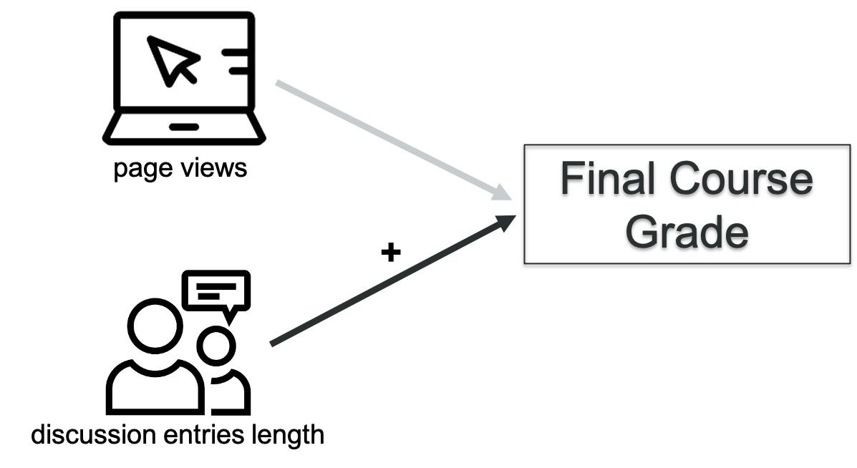
Professional Writing Program Course
ELMS-Canvas activity during entire semester predicting final grade
Notes:
Regression analysis (can provide details if interested) demonstrated that page views were not related to final course grade
Discussion entry length was positively related. For the average number of page views, every ~8,000 character increase in DEL led to a ~4% increase in final grade). Roughly 1.5 pages single-spaced, 12-pt font
R-squared (adjusted) = 45.26%

Slide 24
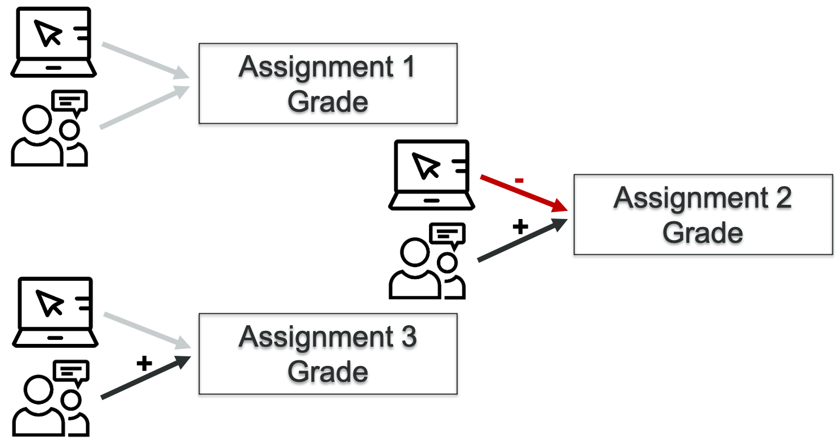
Professional Writing Program Course
ELMS-Canvas activity during assignment module predicting assignment grade
Notes:
Assignment 1: adjusted r-sq = 2%
Assignment 2: adj r-sq = 11%
For the average discussion entries length, every one standard deviation increase in page views (45) led to a 2.02% decrease in proposal grade.
For the average page views, every one standard deviation increase in discussion entries length (2,615) led to a 2.18% increase in proposal grade
Assignment 3: (includes proposal as covariate) adj r-sq = 50%
For the average proposal grade and page views, every one standard deviation increase in discussion entries length (4,264) led to a final project grade increase of 1.39%
Some interesting patterns here. Don’t want to over-interpret, however. Next step is to apply the same analyses to courses that use the same course shell

Slide 25
Instructor partnerships summary
ELMS-Canvas activity generally follows course design
Page views over entire course not related to final grade (in these courses)
Page views and discussion entries length may be related to learning outcomes during modules
Notes:
Affordances of the course space online impact the behavior we see in the system
Activity = page views
Cognitive abilities = WM and explicit rule induction
Module learning assignments: don’t want to overstate what we’ve seen in only 3 sections of 1 course, but there might be something “moving in the bushes” in terms of intentionally designing a course and learning outcomes when we look at this smaller time window

Slide 26
Three Main Take-Aways
ELMS-Canvas:
A critical component of the teaching and learning experience
Patterns in usage provide insights into the overall student learning experience
Data housed within ELMS-Canvas serves robust resource for learning analytic research that can inform instructional design practices
ELMS = Enterprise Learning Management System
Notes:
Interested in student and faculty perceptions of technology (including classroom technology)
Part of a longer story on teaching and learning experiences at UMD
Presenting 2/5 sections (other sections: academic technology and wifi for teaching
Sneak peak before final report, just finished analyzing. If you have follow-up analyses ideas or questions, love to hear about it/get in touch
Future plans: survey instructors like this every other year. Students via ECAR every year

Slide 27
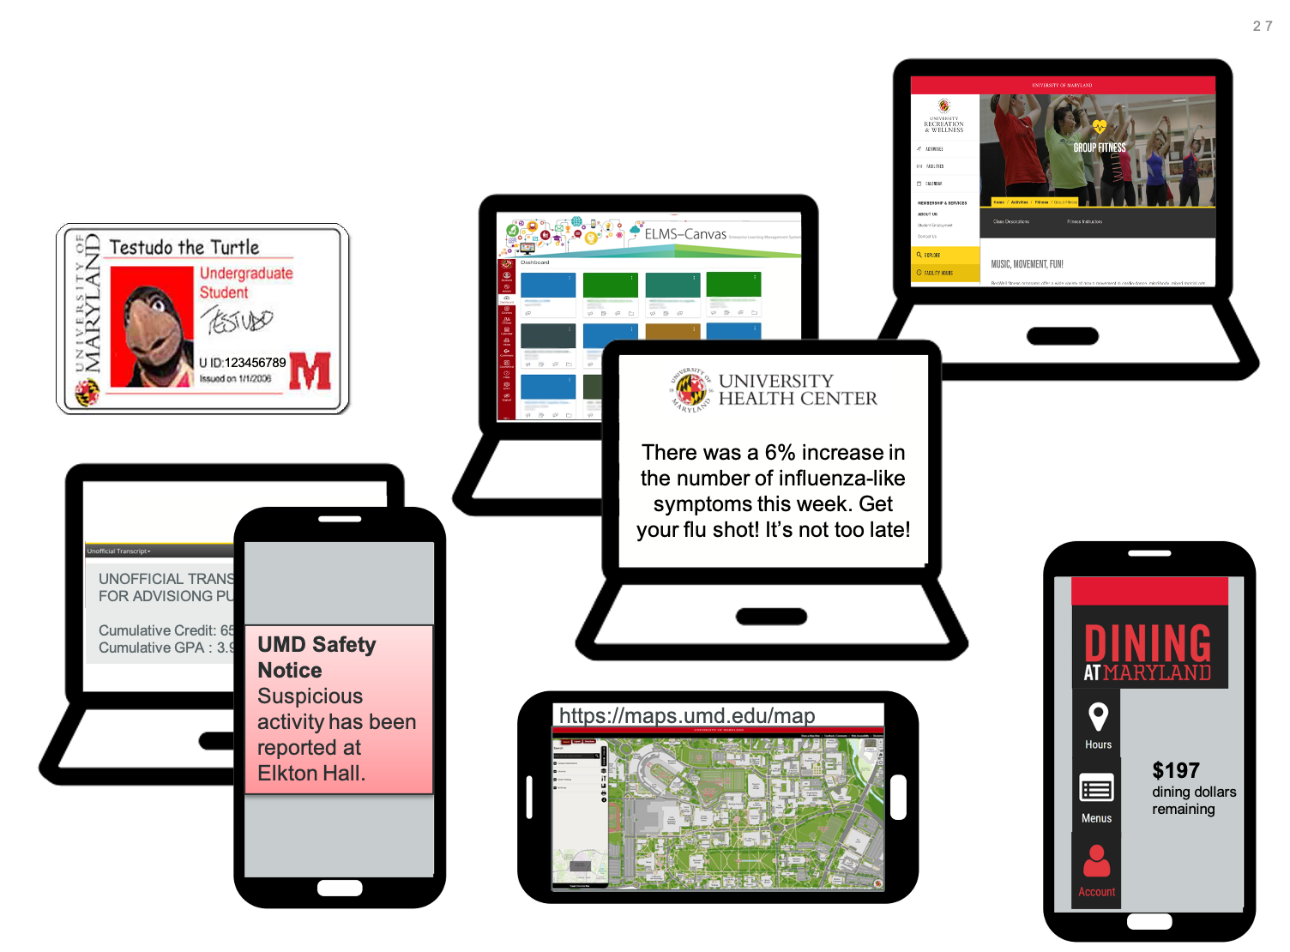
Student information
Notes:
Where do students currently go to look up information?
UID on ID.
Beginning of semester: log into Testudo to see location of class, look it up on UMD maps on their phone.
Then log into ELMS-Canvas to see assignments for the week. Realize they are hungry, so log onto dining account to see how many dining dollars they have left.

Slide 28
Sample Student Dashboard

Slide 29
Megan Masters, PhD | Alia Lancaster, PhD | Martyn Clark, PhD | Phillip Scott Moses
acadtechfeedback@umd.edu

